Slide 1

CT298DS005 Python Project:
Strategic Decision Report: Hong Kong Fund Evaluation
Member: : 6 甘慶腾 甘伯 10 林時鴻 Lambo 16 陶潤桐 To Yun Tung 23 莊漢波 Chong Hon Po
20 馬文明 Franco Ma
LL
2025-5-22

Slide 2


Slide 3
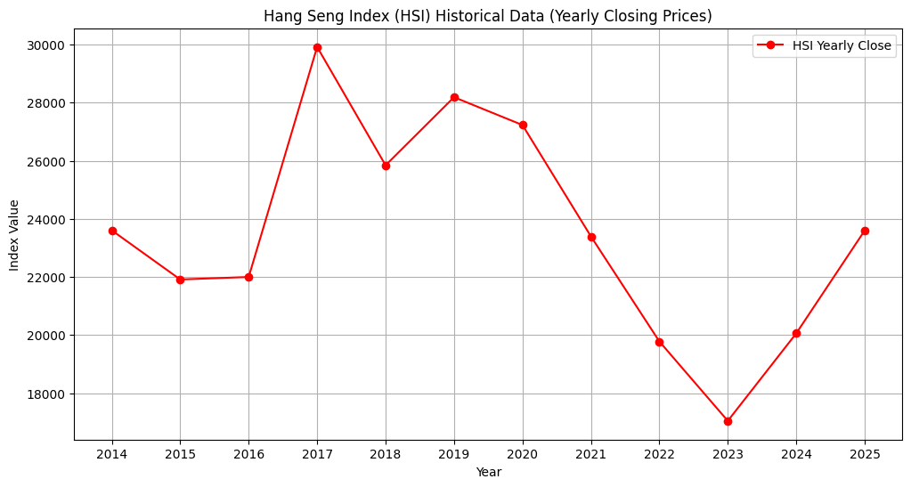

Slide 4

Company Background & Historical Success
Global Investment Leader
Hong Kong Strategic Importance
Blue-Chip Investment Strategy
Founded in 1988 in New York City, our corporation has grown to become one of the largest asset managers worldwide, offering diverse investment and technology services.
Hong Kong has served as a vital financial center for our operations, where we've consistently expanded our presence and generated significant income over decades.
Our portfolio has historically delivered impressive returns with minimal fundamental analysis, focusing primarily on top-tier blue-chip stocks in the Hong Kong market.

Slide 5
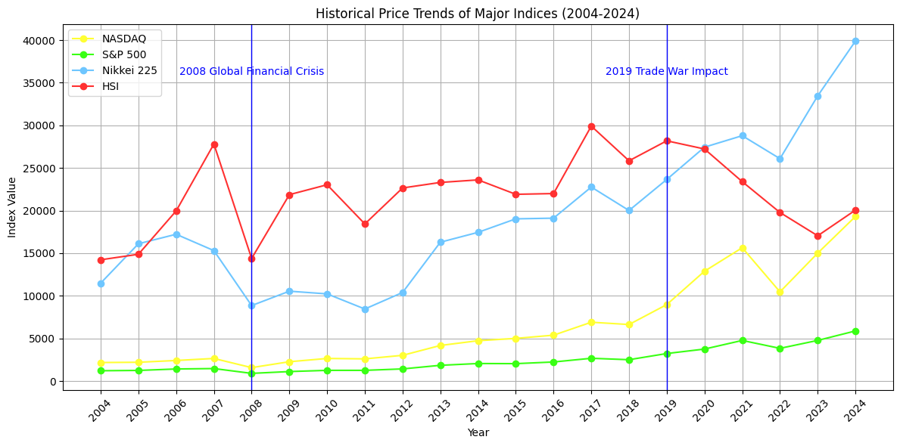
Diagram 1: Time Series Analysis - Historical Performance of Major Global Markets (Nasdaq, S&P, Nikkei)
Nasdaq
S&P
Nikkei
HSI
The Hong Kong stock market has significantly underperformed compared to major global markets since 2019. While Nasdaq, S&P, and Nikkei have shown strong upward trajectories, the Hang Seng Index (HSI) has experienced a concerning decline, particularly exacerbated by the COVID-19 pandemic. This performance gap has resulted in portfolio losses and diminished investor confidence in our Hong Kong fund.

Slide 6
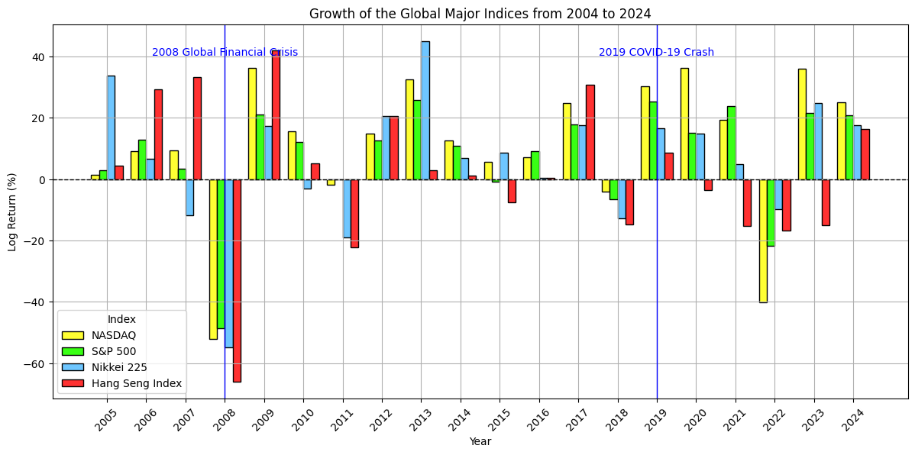
Diagram 2: Logarithmic Income Comparison - Global Major Stock Markets (Nasdaq, S&P, Nikkei)

Slide 7
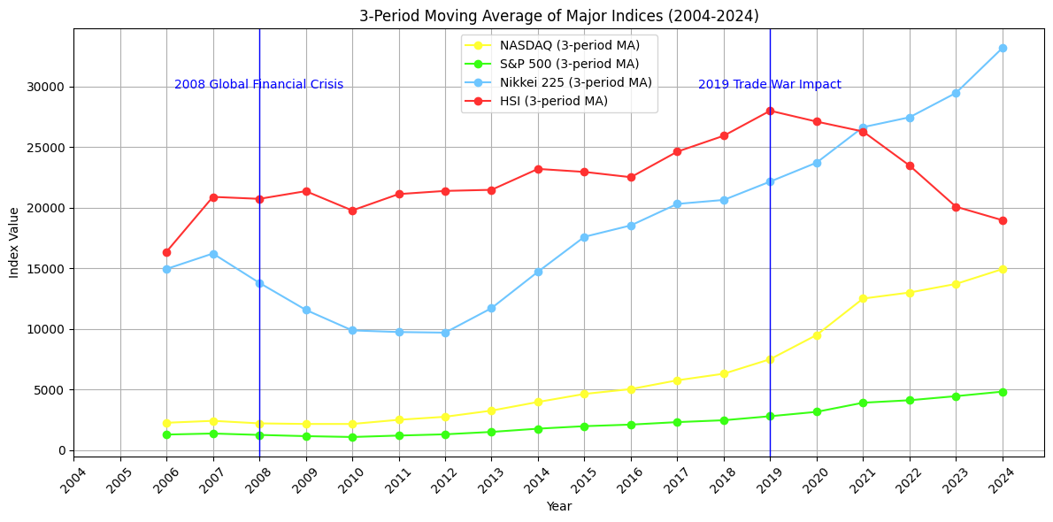
Period Moving Average of Major Indices (2004-2024)

Slide 8
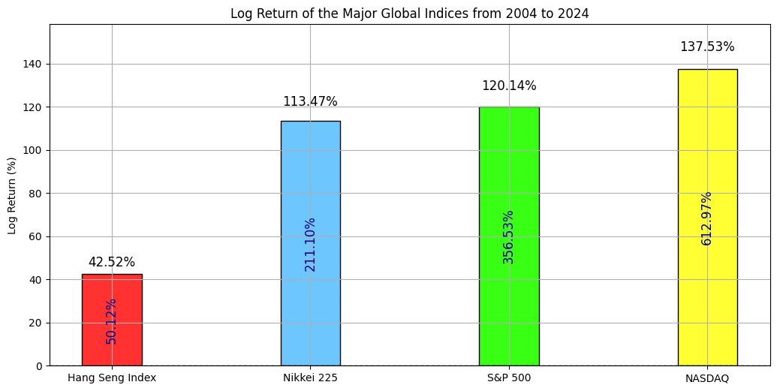

Slide 9





Current Challenges & Decision Point
COVID-19 Impact
The pandemic in 2019 accelerated the Hong Kong market's decline, creating a significant performance gap compared to other global markets.
Competitive Disadvantage
HSI has consistently underperformed against Nasdaq, S&P, and Nikkei, as shown in our time series and logarithmic income comparisons.
Shrinking Assets
Portfolio losses have led to diminished investor confidence and shrinking Managed Underlying Assets (MUA).
Strategic Crossroads
We face a critical decision: continue with the Hong Kong fund or transition to more rewarding markets.

Slide 10

Mission: Performance Projection for 2025
Acknowledge Market Cycles
Recognizing the cyclical nature of markets and our need to navigate through inevitable downturns as part of our long-term investment strategy.
Conduct Regression Analysis
Projecting future performance of the Hong Kong market for 2025 using regression analysis or ARIMA models based on 20 years of historical data (2004-2024).
Evaluate Forecast Results
If the forecast indicates favorable conditions, we will consider continuing our current investment strategy into 2025 and beyond.

Slide 11
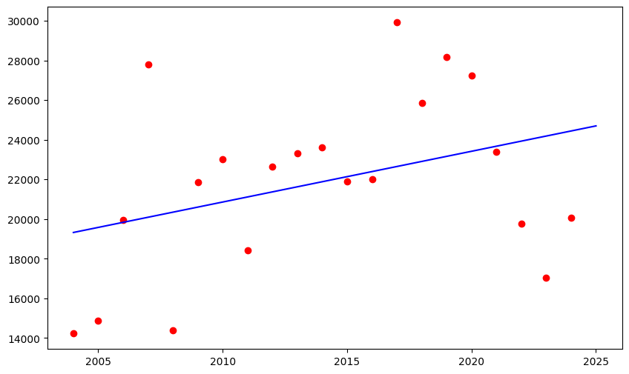
Diagram 3: Regression Analysis or ARIMA - Projection of Future Performance in 2025

Slide 12
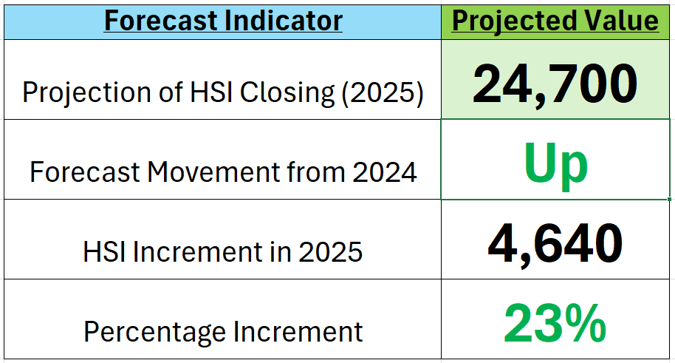
HSI Forecast Summary (2025)

Slide 13

Annual Portfolio Evaluation Process (2021-2024)
1
2021: Initial Selection
Identify fastest-growing stocks using shape model with equal portfolio allocation based on comprehensive selection criteria.
2
2022-2024: Annual Filtering
Evaluate performance at year-end, retaining only the top three performers for subsequent years while adding new high-potential candidates.
3
Performance Tracking
Document performance through detailed shape model analysis diagrams for each year (2021-2024).
4
Comparison
Compare aggregated four-year results against risk-free investments to establish performance gap for decision-making.

Slide 14
Data Collection Process
•Obtain list of securities from HKEX
•Filter out unnecessary securities and export HK Stock Ticker list
•Collect 4 years of stock data from Yahoo Finance:
– Name, Sector, Market Cap
– Revenue, Closing Price
– Dividends, EBITDA, Total Assets
•Calculate financial metrics:
– Return on Assets (ROA)
– Earnings Per Share (EPS)
– Price-to-Earnings (P/E) Ratio
– Growth metrics
•Generate a csv
•Select top 50 stocks by Market Cap for scoring

Slide 15
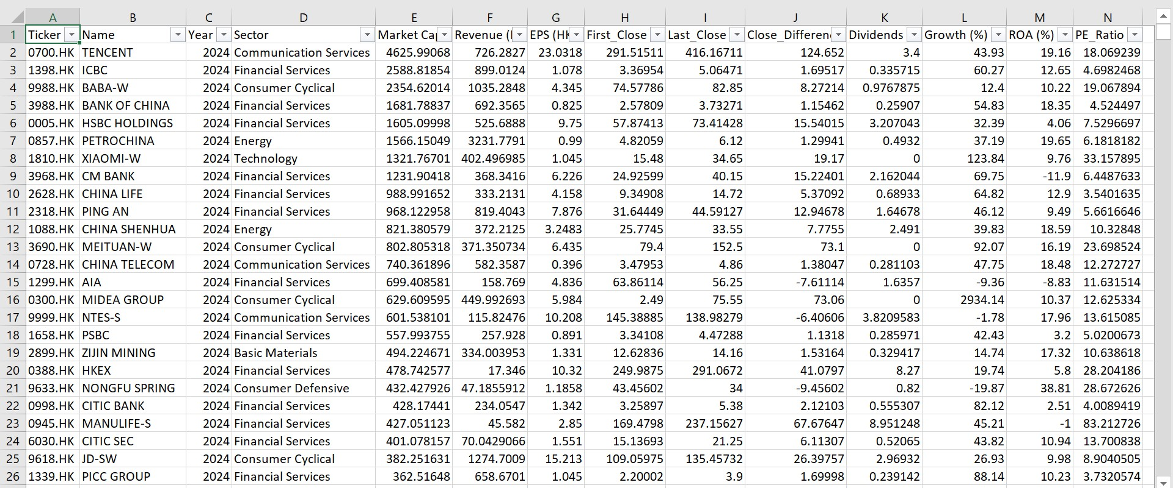

Slide 16
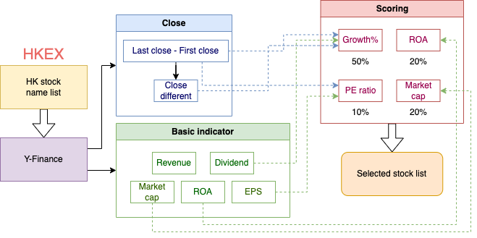

Slide 17
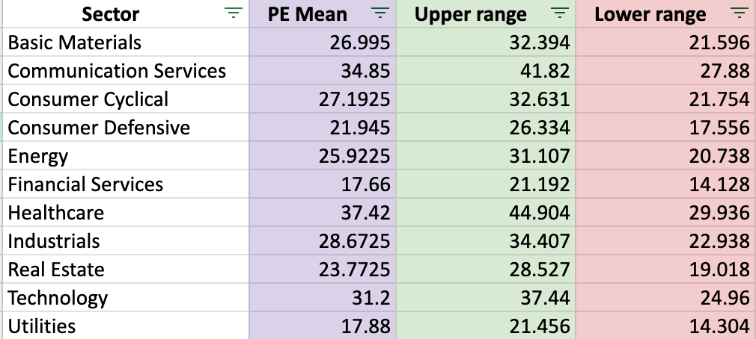
PE score: if pe < lower range or > upper range = -2

Slide 18
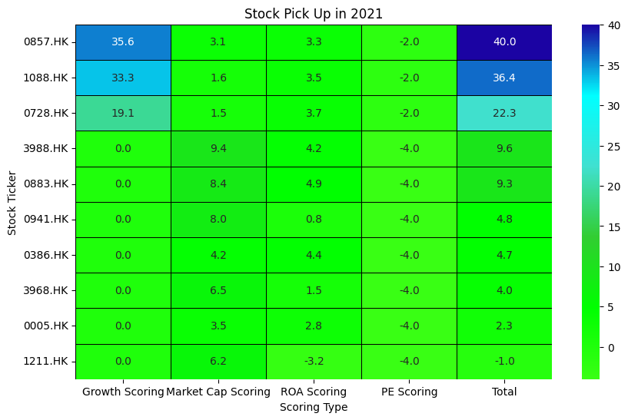


Slide 19
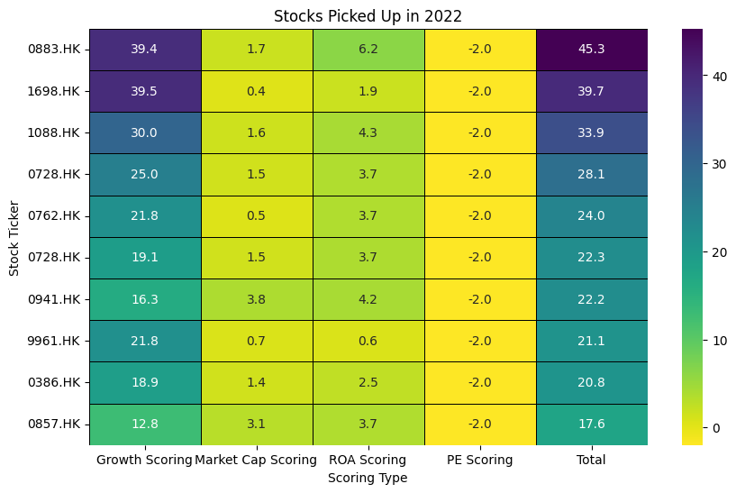

Slide 20
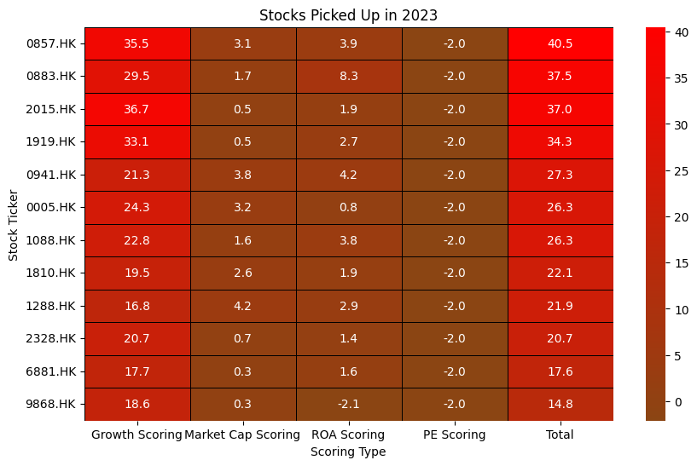


Slide 21
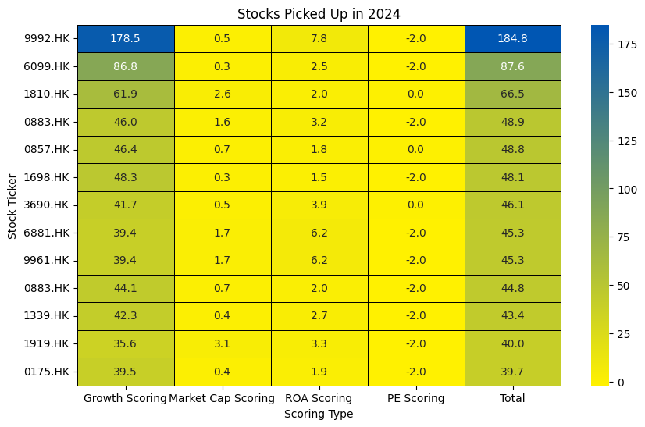

Slide 22
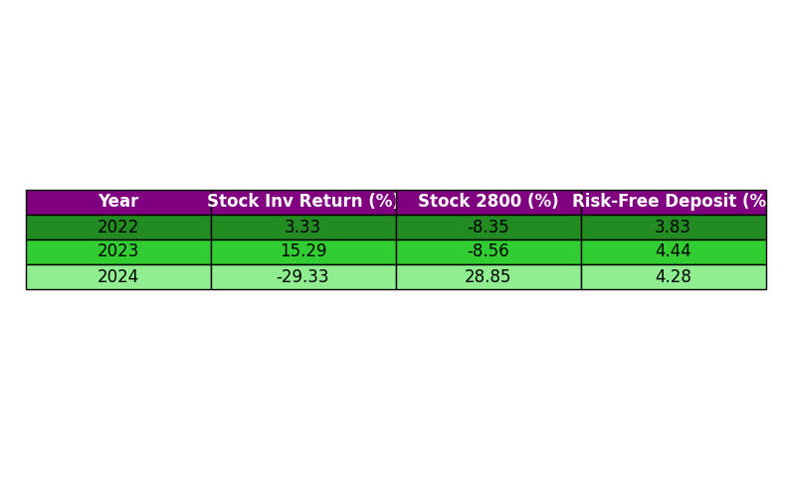

Slide 23
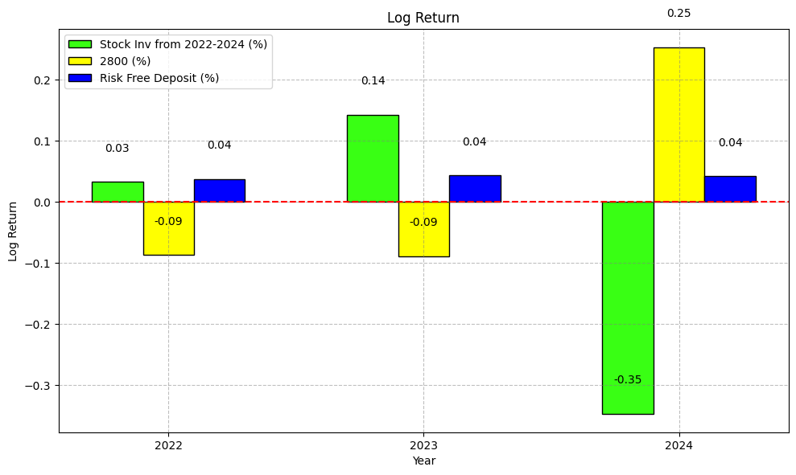

Slide 24


Slide 25
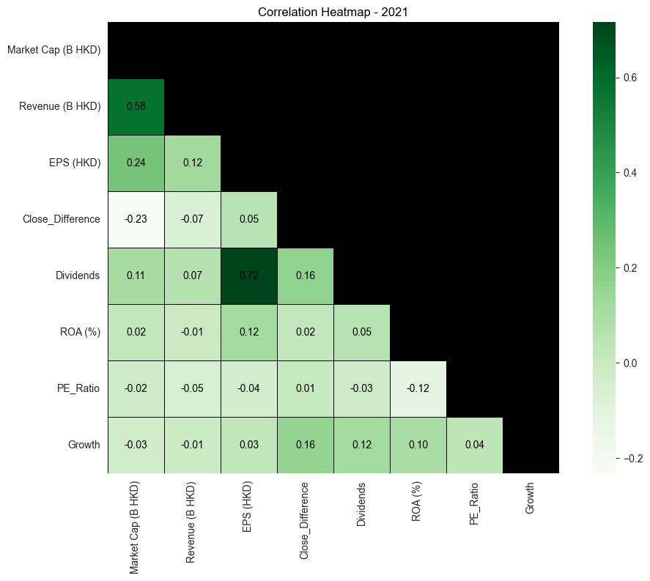

Slide 26
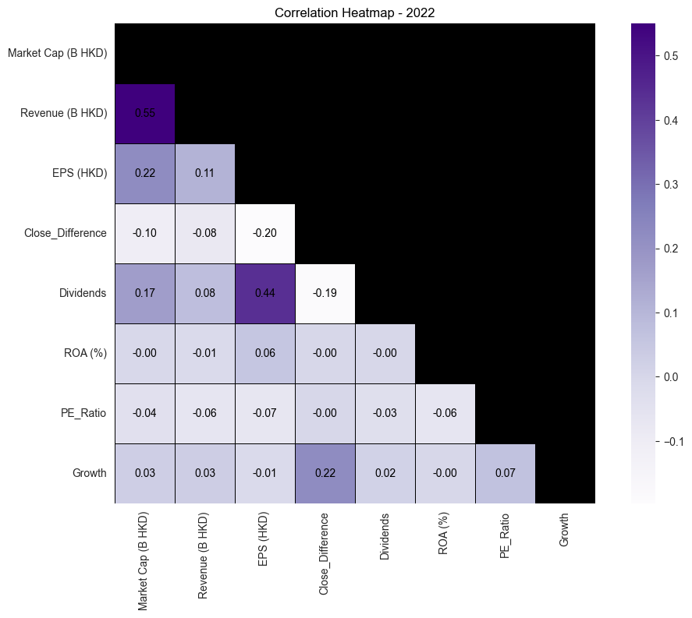

Slide 27
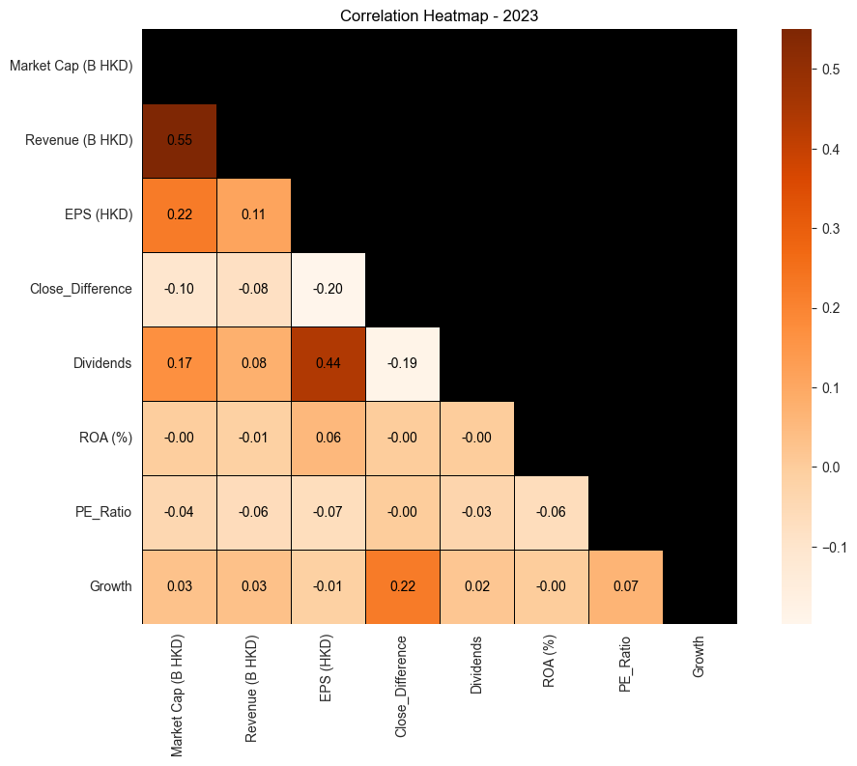

Slide 28
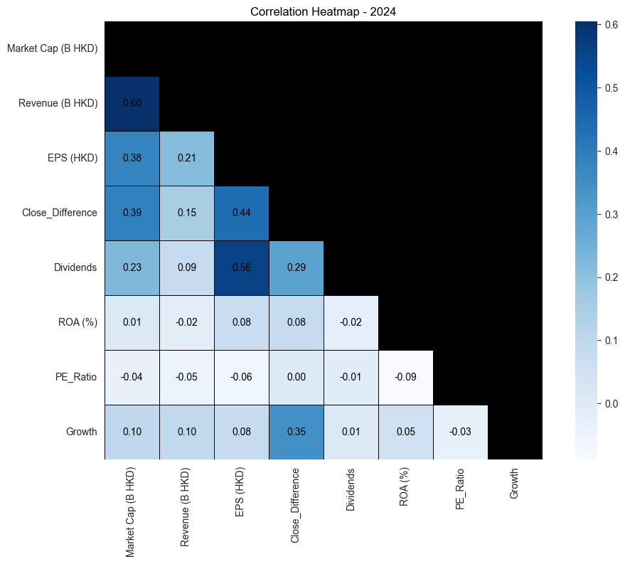

Slide 29
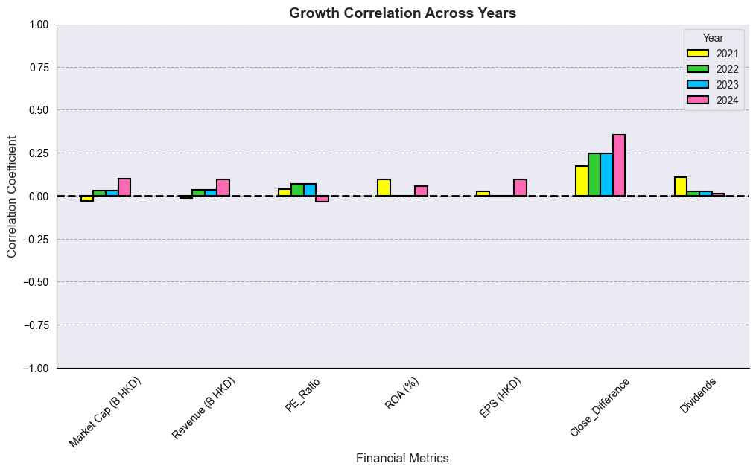

Slide 30

Q & A

